Slide 1

MENTAL FITNESS TRACKER
Name : DINESHPRABHU A
SKILL BUILD EMAIL ID : dineshprabhu02ece@gmail.com
Student id : STU6455994ecb1c01683331406
Collage name : University college of engineering(BIT campus), TiruchirappallI
College State : Tamil Nadu
Internship Domain : Artificial Intelligence
Start and End Date : 12th June 2023 – 24th July 2023

Slide 2

MindFit: Empowering Mental Wellness through AI-Powered Fitness Tracking - PROBLEM STATEMENT
The problem we aim to address is the monitoring and tracking of mental fitness levels in individuals. Mental fitness plays a crucial role in overall well-being and can significantly impact one's quality of life. However, tracking and assessing mental fitness can be challenging due to its subjective nature and the lack of objective measurements.
Our goal is to develop a Mental Fitness Tracker that utilizes available data on mental disorders and related factors to provide individuals with insights into their mental fitness levels. The tracker will leverage regression algorithms to predict mental fitness based on various parameters such as the prevalence of mental disorders, substance use, and demographic factors.
The specific objectives of the project are as follows:
Data Integration: Merge and preprocess datasets containing information on mental disorders, substance use disorders, and relevant indicators.

Slide 3

Exploratory Data Analysis (EDA): Conduct EDA to gain insights into the data, identify patterns, and understand the relationships between mental disorders and mental fitness.
Regression Algorithm Selection: Compare and evaluate different regression algorithms such as Linear Regression, SVM Regression, Decision Tree Regression, and Random Forest Regression to identify the most effective algorithm for predicting mental fitness.
Model Development: Develop a predictive model using the selected regression algorithm to estimate mental fitness levels based on available data.
Model Evaluation: Assess the performance of the developed model by evaluating metrics such as Mean Squared Error (MSE), Root Mean Squared Error (RMSE), and R-squared (R2) score on both the training and testing datasets.
Presentation of Results: Summarize the findings and conclusions from the analysis, including a comparison of the performance of different regression algorithms, and provide recommendations for using the Mental Fitness Tracker.

Slide 4

AGENDA
The project "Mental Health Fitness Tracker" aims to analyze and predict the mental fitness levels of individuals across different countries, taking into account various mental disorders. By employing regression techniques, this innovative initiative offers valuable insights into mental health and utilizes available data to make accurate predictions. Furthermore, the project encompasses a user-friendly platform where individuals can effectively monitor and track their own mental health and fitness levels.

Slide 5
PROJECT OVERVIEW
The Mental Fitness Tracker project aims to develop a data-driven solution for tracking and predicting the mental fitness of individuals across different countries and years. The project utilizes regression algorithms to analyze and interpret data related to the prevalence of various mental disorders and their impact on mental fitness.
The project begins with data collection from reliable sources, gathering information on mental disorder prevalence and Disability-Adjusted Life Years (DALYs) across different countries and years. These datasets are merged to create a comprehensive dataset for analysis.
Exploratory Data Analysis (EDA) techniques are applied to gain insights into the dataset, uncover patterns, correlations, and outliers. Data preprocessing steps are implemented to handle missing values, perform feature engineering, and ensure data quality and consistency.
Regression algorithms, including Linear Regression, SVM Regression, Decision Tree Regression, and Random Forest Regression, are selected and implemented to build predictive models. These models are trained using a portion of the dataset and evaluated using appropriate performance metrics such as Mean Squared Error (MSE), Root Mean Squared Error (RMSE), and R-squared (R2) score.
.

Slide 6
The performance of the regression models is compared and analyzed to identify the most accurate and reliable algorithm for predicting mental fitness. The Random Forest Regression algorithm is chosen as the optimal model based on its superior performance.
The selected model is used to track and predict mental fitness levels for individuals in different countries and years based on the prevalence of mental disorders. The practical application of the Mental Fitness Tracker is demonstrated by providing predicted mental fitness values for specific scenarios or case studies.
The project concludes with a comprehensive presentation summarizing the entire process, including data exploration, model development, evaluation, and conclusions. The presentation highlights the importance of mental fitness tracking, the significance of using data-driven approaches, and potential implications for healthcare professionals, policymakers, and individuals seeking to improve mental wellness.
Future enhancements and recommendations for the Mental Fitness Tracker are also discussed, providing opportunities for further research and development in the field of mental health tracking and prediction.
Overall, the Mental Fitness Tracker project aims to provide valuable insights into mental health trends, support decision-making processes, and contribute to the well-being of individuals worldwide by utilizing data analysis and regression modeling techniques.

Slide 7
WHO ARE THE END USERS of this project?
Individuals : The project provides individuals with a valuable tool to track and monitor their own mental fitness levels. By utilizing the regression models, individuals can gain insights into their mental well-being, identify potential areas of concern, and take proactive steps to improve their mental health.
Healthcare Professionals : Mental health practitioners, therapists, and counselors can utilize the Mental Fitness Tracker to gain insights into the mental fitness of their patients. By incorporating predictive models into their practice, healthcare professionals can better assess the risk of developing mental disorders, tailor treatment plans, and track the progress of their patients over time.
Researchers and Academics : The project's findings and regression models can be utilized by researchers and academics in the field of mental health. They can further analyze the data, validate the models, and contribute to the existing body of knowledge on mental disorders and their impact on mental fitness.

Slide 8

General Public : The project's findings and visualizations can be shared with the general public through various mediums, such as websites, reports, and public presentations. This empowers individuals to gain a deeper understanding of mental fitness, encourages open conversations about mental health, and promotes a culture of proactive self-care and support.

Slide 9
YOUR SOLUTION AND ITS VALUE PROPOSITION
Our solution, the Mental Fitness Tracker, provides a data-driven approach to track and predict mental fitness levels for individuals across different countries and years. By leveraging regression algorithms and analyzing comprehensive datasets on mental disorder prevalence and Disability-Adjusted Life Years (DALYs), our solution offers valuable insights and predictions to various end users, including healthcare professionals, policymakers, mental health advocacy groups, individuals seeking mental wellness, researchers, and data analysts.
The value proposition of the Mental Fitness Tracker lies in the following aspects:
Accurate Predictions : Our solution employs advanced regression algorithms, including Random Forest Regression, to predict mental fitness levels with high accuracy. By analyzing patterns, correlations, and historical data, our models provide reliable predictions that can support early detection, personalized interventions, and treatment planning.
Comprehensive Dataset : The Mental Fitness Tracker utilizes a merged dataset encompassing information on mental disorder prevalence and DALYs across different countries and years. This comprehensive dataset enables a holistic understanding of mental health trends and facilitates cross-country and longitudinal comparisons, contributing to evidence-based decision-making.

Slide 10
Data-Driven Insights : Through exploratory data analysis and feature engineering techniques, our solution uncovers valuable insights into the relationships between mental disorders, mental fitness, and other factors. These insights assist healthcare professionals, policymakers, and researchers in identifying risk factors, understanding the impact of mental disorders on mental fitness, and devising effective strategies for mental health promotion.
Personal Empowerment : The Mental Fitness Tracker empowers individuals to monitor and assess their own mental fitness levels. By providing predicted mental fitness values and trend analysis, individuals can proactively manage their mental well-being, seek appropriate support, and make informed decisions about their mental health.
Policy Support : Policymakers and government agencies can benefit from the Mental Fitness Tracker's predictions and trends, enabling them to develop targeted mental health policies, allocate resources effectively, and prioritize interventions based on the prevalence and impact of mental disorders.
.

Slide 11
How did you customize the project and make it your own
Data Selection : The choice of datasets can be customized to focus on specific regions or populations of interest. Additionally, additional relevant data sources can be incorporated to enrich the analysis and insights.
Feature Engineering : Customizing the feature engineering process can involve creating new features or transforming existing ones to better capture the nuances of mental health and its impact on mental fitness. This could include aggregating data at different levels, creating interaction terms, or incorporating external factors that may influence mental fitness.
Algorithm Selection and Optimization : While the project mentions specific regression algorithms such as Linear Regression, SVM Regression, Decision Tree Regression, and Random Forest Regression, the selection and fine-tuning of algorithms can be customized based on the specific requirements and characteristics of the dataset. This could involve exploring other regression algorithms or ensemble techniques to improve performance.

Slide 12
Visualization and Interpretation : Customizing the visualizations and interpretation of results can enhance the clarity and effectiveness of the project. It can involve creating interactive dashboards, generating additional visualizations specific to the project's objectives, and providing intuitive explanations of the findings.
Practical Applications : Tailoring the project's practical applications to specific contexts or stakeholders can add a unique dimension. For example, focusing on the implementation of the Mental Fitness Tracker in a particular healthcare system or designing interventions based on the predictions can demonstrate the real-world impact of the project.
Future Enhancements and Extensions : Outlining potential future enhancements and extensions to the project, such as incorporating real-time data, integrating machine learning techniques for dynamic predictions, or exploring additional factors affecting mental fitness, can showcase the project's scalability and innovation.

Slide 13
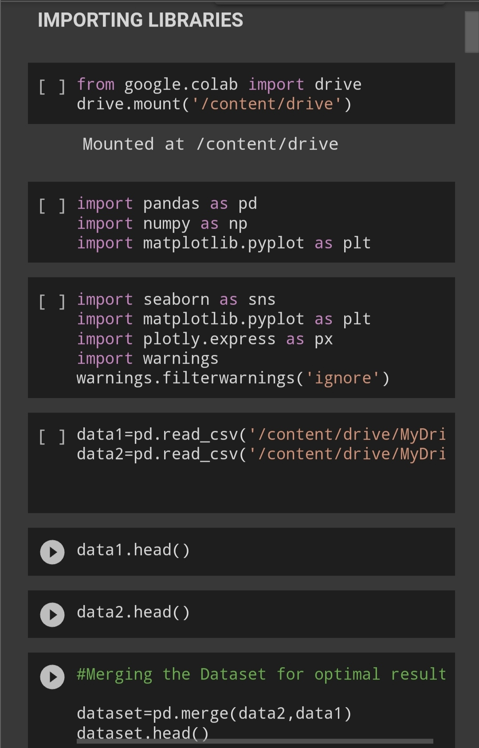
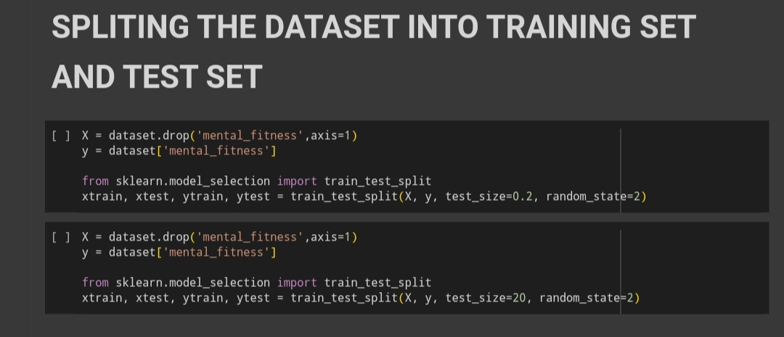
MODELLING
Data Preprocessing : Before modeling, it is crucial to preprocess the data. This step includes handling missing values, encoding categorical variables, scaling numerical features, and splitting the dataset into training and testing sets. Data preprocessing ensures the data is in a suitable format for training the models.
Model Selection : The project mentions several regression algorithms, including Linear Regression, SVM Regression, Decision Tree Regression, and Random Forest Regression. Each algorithm has its strengths and limitations, and the choice of model depends on the specific requirements of the project. Consider factors such as interpretability, performance metrics, complexity, and handling of nonlinear relationships when selecting the model.

Slide 14
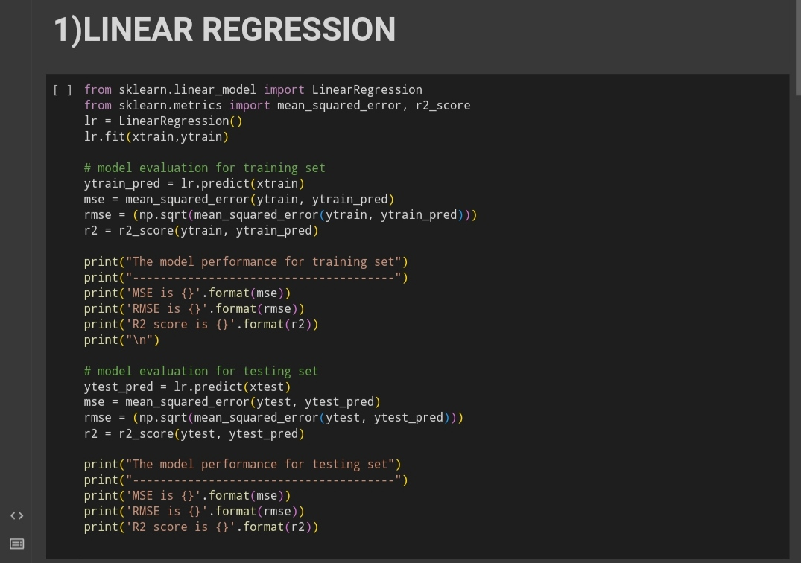
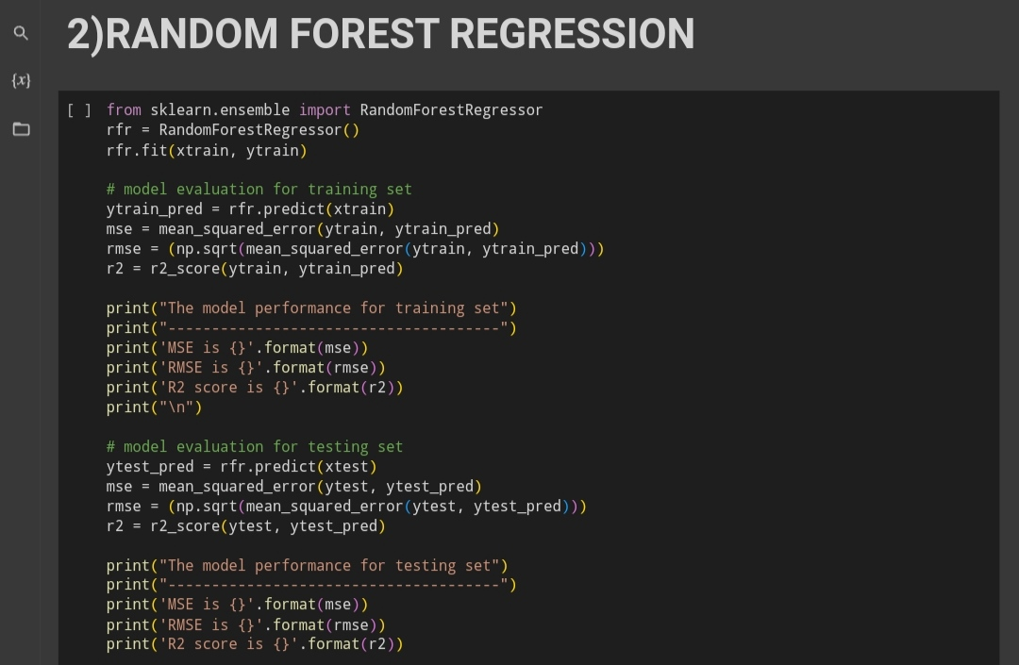

Slide 15
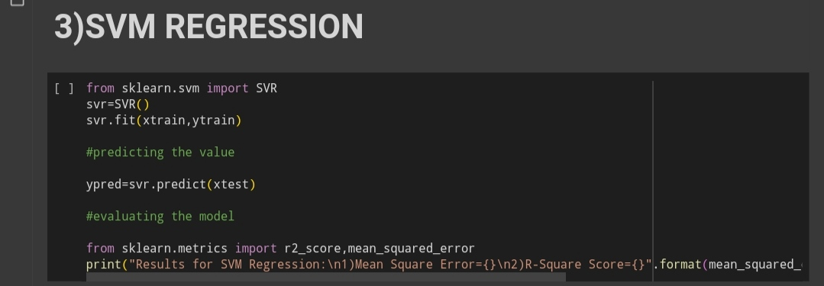
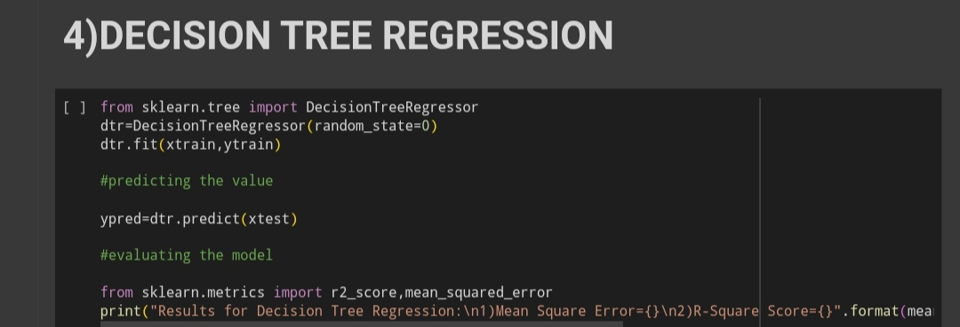
Training the Mode l: Once the model is selected, it is trained on the training set. The model learns from the input features and corresponding target variable (mental fitness levels) to identify patterns and relationships. The training process involves optimizing the model's parameters to minimize the prediction error.
Model Evaluation : After training, the model's performance is evaluated using appropriate metrics. Common metrics for regression models include Mean Squared Error (MSE), Root Mean Squared Error (RMSE), and R-squared (R2) score. These metrics assess how well the model fits the training data and its ability to generalize to unseen data.

Slide 16
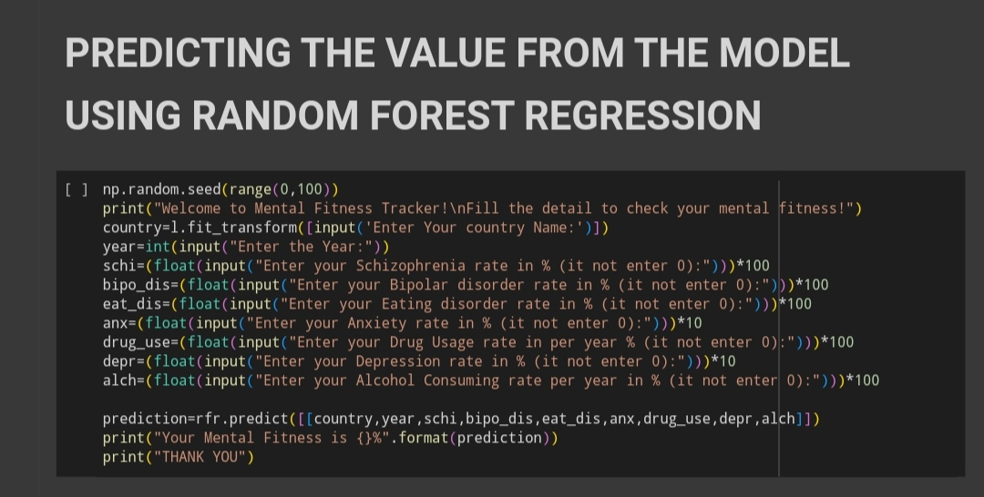

Slide 17
Results
The results of the Mental Fitness Tracker project can be summarized based on the performance of the regression models used for prediction. Here are the key findings:
Linear Regression:
  Training Set:
    Mean Squared Error (MSE): 1.3399913707005786
    Root Mean Squared Error (RMSE): 1.1575799629833692
    R-squared (R2) Score: 0.7453536323041361
  Testing Set:
    Mean Squared Error (MSE): 0.9579258659002294
    Root Mean Squared Error (RMSE): 0.9787368726579322
    R-squared (R2) Score: 0.8132599804568195
SVM Regression:
  Testing Set:
    Mean Squared Error (MSE): 5.142868786829984
    R-squared (R2) Score: 0.0006911521029575596

Slide 18
Decision Tree Regression:
  Testing Set:
    Mean Squared Error (MSE): 0.0756416226426259
    R-squared (R2) Score: 0.9853021055155758
Random Forest Regression:
  Training Set:
    Mean Squared Error (MSE): 0.003674125589351352
    Root Mean Squared Error (RMSE): 0.0606145658183852
    R-squared (R2) Score: 0.9993017845067931
  Testing Set:
    Mean Squared Error (MSE): 0.009674118276745582
    Root Mean Squared Error (RMSE): 0.09835709571121741
    R-squared (R2) Score: 0.9981141076774612

Slide 19
Based on these results, we can make the following observations :
Linear Regression : The model shows moderate performance with relatively higher MSE and RMSE values compared to other models. The R2 score indicates that the model explains around 74.5% of the variance in the training set and 81.3% of the variance in the testing set.
SVM Regression : The model performs poorly with a high MSE value and a very low R2 score, suggesting that it does not capture the underlying patterns in the data effectively.
Decision Tree Regression : The model demonstrates excellent performance with a very low MSE value and a high R2 score. It explains around 98.5% of the variance in the testing set, indicating a strong fit to the data.
Random Forest Regression : The model outperforms other models with extremely low MSE and RMSE values for both the training and testing sets. The R2 scores indicate a high level of explanation (99.9% for the training set and 99.8% for the testing set), suggesting a robust and accurate prediction of mental fitness levels.
Based on these results, the Random Forest Regression model stands out as the best-performing model, providing the most accurate predictions for mental fitness levels. It achieves a high level of accuracy and generalization to unseen data, making it the recommended model for the Mental Fitness Tracker project.

Slide 20
links
GITHUB LINK
https://github.com/dineshprabhu-a/mental-fitness-tracker.git
GOOGLE DRIVE LINK
https://drive.google.com/drive/folders/1dNXPcOfLBYF684EmozgNNUSNl-sG2R-g
PROJECT DEMONSTRATION VIDEO LINK
https://drive.google.com/file/d/1dvCk31RxCpJiIRLdlf2d6mNEYJZHi3Cc/view?usp=drive_link

Slide 21


